Slide 1
Sustainable Design and Manufacturing:
Including Environmental and Social Considerations
Bert Bras
Sustainable Design & Manufacturing
George W. Woodruff School of Mechanical Engineering
Georgia Institute of Technology
Atlanta, GA 30332-0405
www.sdm.gatech.edu
Notes:
Value Chain: advantage – will appeal to all companies on our target list, all we do fits in it, descriptive, not claimed yet.
Suatainable Enterprise: advantage – broader, can claim more space in Institute possibly. Disadvantage – generic, already taken by other universities, not very descriptive.
VT: How about something that is more appealing and easier to understand? Maybe Environment and Business? Or Environment, Industrial Systems, and Business?
Un. Toronto, Massey College sponsors Massey Lecture. Franklin began her career during World War II, but was imprisoned in a Nazi work camp because her mother was Jewish. She spent the rest of the war repairing bombed buildings. Franklin was a pioneer in the field of archaeometry, which applies modern materials analysis to archaeology. In the early 1960s, she investigated levels of strontium 90 -- a radioactive isotope in fallout from nuclear weapons testing -- in children's teeth. Her research was instrumental in the cessation of atmospheric weapons testing.

Slide 2
A Real Story
Dutch officials seize cadmium-packed PlayStation kit
Sony wonders what fuss is about
By Tony Smith
Posted in Personal, 5th December 2001 11:51 GMT
Dutch customs officers yesterday impounded 1.3 million PlayStations and 800,000 accessory packs worth over 180 million Euro ($160.25 million) after environmental protection inspectors discovered they were a potential threat to the environment.
Think-Pair-Share: Why is this bad? What is the problem? Who is to blame?

Slide 3
Sustainability: Common Definition
“development that meets the needs of the present generation without compromising the needs of future generations.”
  United Nations’ World Commission on Environment and Development in their report “Our Common Future”, 1987

Slide 4






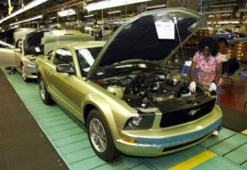
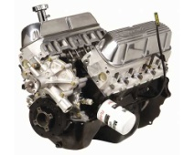
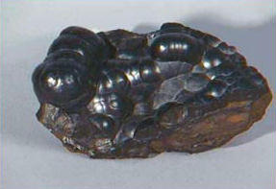
Sustainability: Working within the Physical Limits
Waste
(land, water, air emissions
Ecosystems
Urban Regions
Power Sources
(Sun, Moon, Earth)
Society
Nature
Use
Product Re-X
Industry
Distribution
Earth
Extraction
Production
Sourcing
Material
Bottom-line: The extractive capability of humanity (and its industrial system) must be balanced with the regenerative capacity of the Earth.

Slide 5
Sustainability’s “Triple Bottom Line”
Sustainability is defined in three dimensions:
Environmental
  Destroying our resources will hurt us long term
  Some materials already getting scarce
Financial
  Being bankrupt helps nobody
Social
  Quality of Life should go up
  Workforce education and retention
Goal is to have win-win-win technologies and solutions
“Green Economy”
“People-Planet-Profit”

Slide 6
Why do Businesses Care?
Legislation: It’s the Law!
  It’s the law. Clean Air Act, Clean Water Act, etc.
Risk & Liability: Your product can make somebody sick or kill
  Using hazardous materials or processes can be risky and create many liabilities
Customers: Nobody wants a product that kills of injures people, animals, etc.
  Awareness of environmental issues is increasing among customers – especially businesses
  Industrial customers (e.g., Original Equipment Manufacturers) do not want (future) environmental liability for your product.
Image: Image is everything
  Being “green” is good.
ISO 14000: Your customer tells you to comply with Environmental Management Standard
  ISO 14000 (environmental management standards) certification has become an important element in doing business, like ISO 9000 (quality management standards).
It makes good business sense!
  Less waste = more money!
  Driver for innovation and new creative solutions

Slide 7
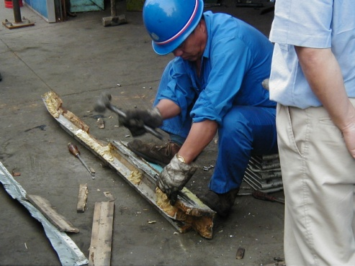
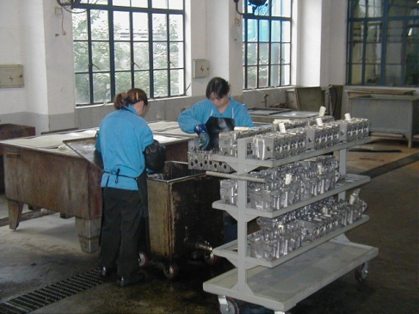
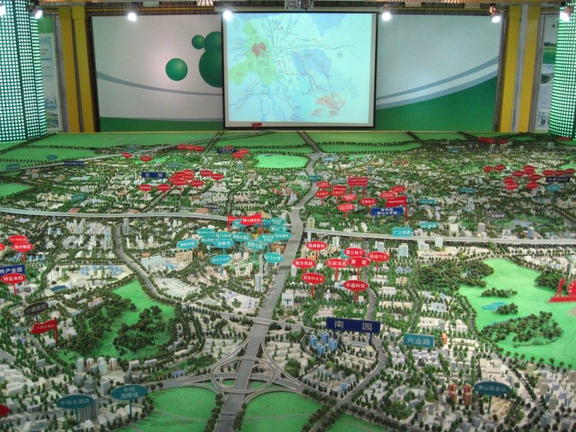
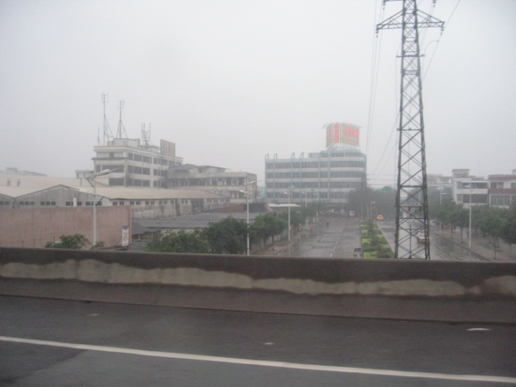
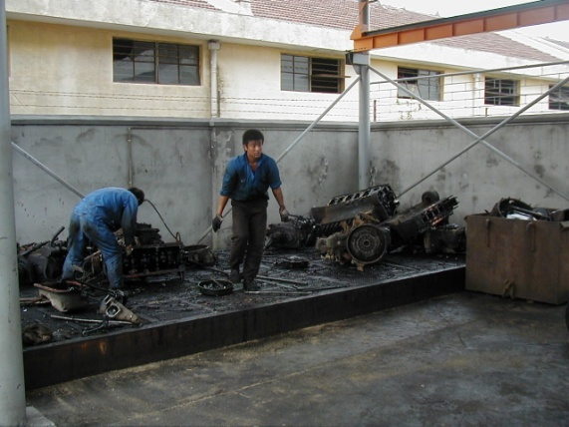
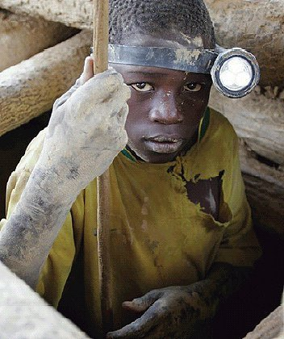
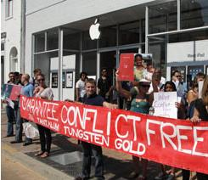


Image is Everything

Slide 8
Important Concept: Life Cycle Thinking
Instead of “just” manufacturing, also think about environmental and social impacts during a products use, service and end of life
Schematic of Product Life-Cycle
Bras, B. (1997). "Incorporating Environmental Issues in Product Realization." United Nations Industry and Environment 20(1-2): 7-13.
A full assessment of impacts over a life cycle is called “Life-Cycle Assessment” (LCA) and is codified in ISO 14040 standards.
  LCA examines the environmental burdens and impact of a product over its entire life-cycle (see ISO 14040)

Slide 9
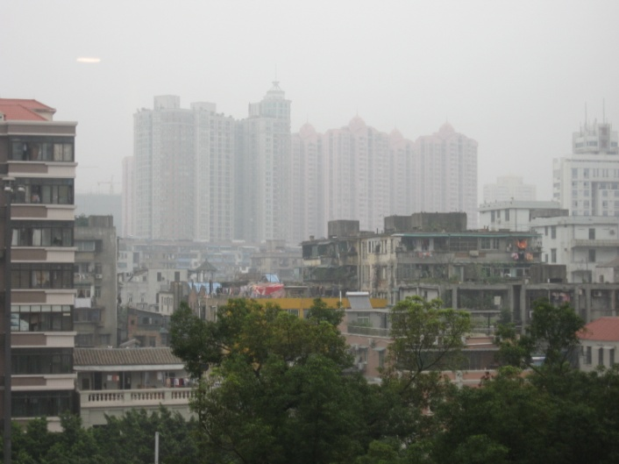
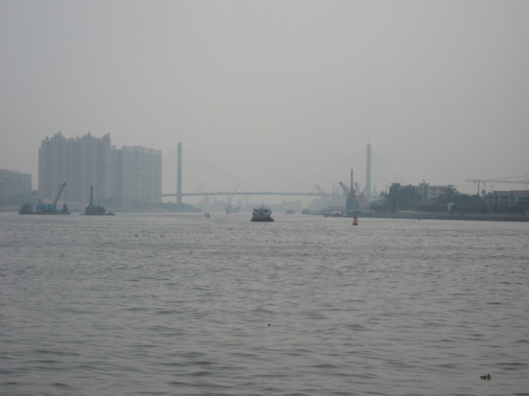
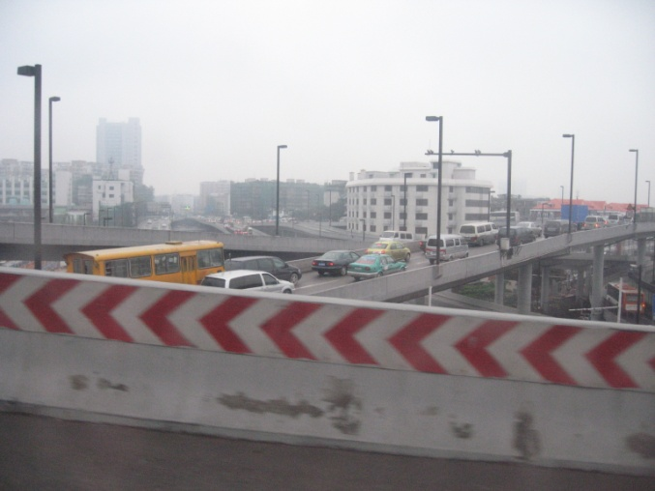
Upstream Sustainability Challenges Overseas
China, India, etc., are all facing severe environmental, health, and quality of life problems as a result of their industrial growth
As a US designer and firm, you may be contributing to their problems

Slide 10
Material Legislation is Everywhere
Many materials are subject to legislations/regulations because they cause harm in some way
Major US and EU companies all comply with legislation
For an example list of international regulations, look at automotive industry Global Automotive Declarable Substance List (GADSL):
  133 materials that may be in automotive parts
You can download GADSL spreadsheet:
  http://www.americanchemistry.com/s_plastics/doc.asp?CID=1106&DID=9293
  For automotive projects, check whether your design contains any of these materials
  If so, disclose in report

Slide 11
EPA and Toxic Release Inventory (TRI)
In the US, look at the EPA “list of lists” to see when you should worry about permits and special rules
  www.epa.gov/ceppo/pubs/title3.pdf
You have to fill in a TRI = Toxic Release Inventory (like a tax report) if you use certain hazardous chemicals in manufacturing and filings are posted online:
  www.epa.gov/triexplorer/
  Trivia: According to TRI, who do you think is a) the biggest air polluter and b) the biggest land polluter?
Best thing is not to use any of these chemicals or let somebody else (your supplier) deal with it

Slide 12




EU (& China): Restriction of Hazardous Substances (RoHS)
RoHS is often referred to as the lead-free directive, but it restricts the use of the following six substances:
  Lead (Pb)
  Mercury (Hg)
  Cadmium (Cd)
  Hexavalent chromium (Cr6+)
  Polybrominated biphenyls (PBB)
  Polybrominated diphenyl ether (PBDE)
    PBB and PBDE are flame retardants used in several plastics.
Lots of companies want suppliers to certify that they are “RoHS compliant”
If one part is not compliant, the whole product is not!
  Make sure your design is RoHS compliant!
    Check for RoHS compliance label when ordering

Slide 13
Tool: Material Safety Data Sheets (MSDS)
Check MSDS of materials if you want to be safe w.r.t. any health risks from a material you want to use in your design
  Also think about worker safety (OSHA)
MSDS can be obtained from material providers
  Should be available upon request or online
GREAT list of online MSDS and related databases is at:
  http://www.ilpi.com/msds/
Quick and easy online (free) MSDS database:
  http://hazard.com/msds/
If applicable, include MSDS in your report (appendix)

Slide 14
End Of Life
Linear Production: “Take, make, waste” (our current system)
Closed Loop Production (“future” system)

Slide 15
WEEE Directive
The Waste Electrical and Electronic Equipment Directive (WEEE Directive) is the European Community directive 2002/96/EC on waste electrical and electronic equipment (WEEE) which sets collection, recycling and recovery targets for all types of electrical goods.
Original Equipment Manufacturers are responsible for appropriate collection and treatment.
Each country can have different implementation
Think about how you will ensure that your (electronic) product will not end up on a landfill and can be recycled.

Slide 16
Energy
Energy is something we use a lot and comes from different sources with different consequences (including death)
Much of our energy comes from materials
Using energy has environmental consequences:
  Air pollution
  Green house gas emissions
    Example: gasoline => 19.564 lbs CO2/gallon
  Water consumption
DoE Energy Information Agency (EIA)
  One of the best sources to find all kind of info on energy
  http://www.eia.doe.gov/

Slide 17
Product Use Phase – Try to save energy!
Typically, any energy consuming product has the largest environmental impact in its use phase
  Exceptions always exist
Conservation is good!
  Every kWh or Joule saved by the product saves another 2-3 upstream
Beware of “rebound effect”
  You created a more efficient product, but now it is going to be used more

Slide 18

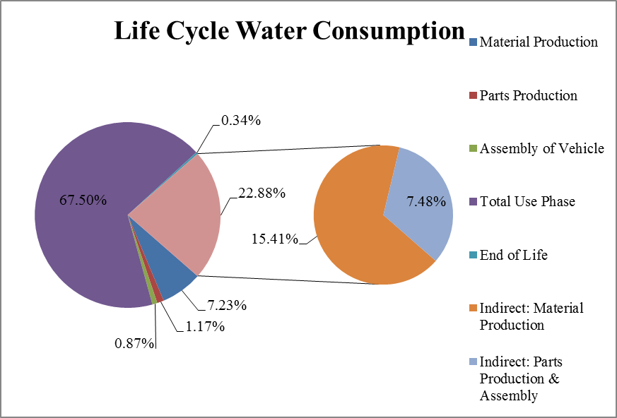
The Water Dimension
Water is becoming more and more important
Water is consumed everywhere in a product life cycle, incl. in energy production
  Water Consumption: Freshwater withdrawals which are evaporated, incorporated in products and waste
  Water Use (withdrawal): Water that goes into a system. Most of this typically leaves the system as waste water
Stage | Water Consumption (Liters)
Direct Material Production | 5,569
Direct Parts Production | 902
Direct Vehicle Assembly | 670
Total Use Phase | 51,965
Direct End of Life | 259
Indirect: Material Production | 11,859
Indirect: Parts & Assembly | 5,757
Total | 76,981
Tejada, F., Bras, B., and T. Guldberg (2012). Direct and Indirect Water Consumption in Vehicle Manufacturing. Paper DETC2012-71307, Proceedings of the ASME 2012 International Design Engineering Technical Conferences & Computers and Information in Engineering Conference, Chicago, IL, Aug 12-15.
Typical water consumption from electricity generation is around 0.5 gallons/kWh for thermo-electric plants

Slide 19
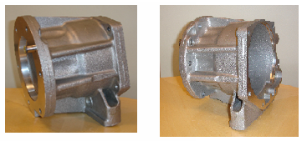
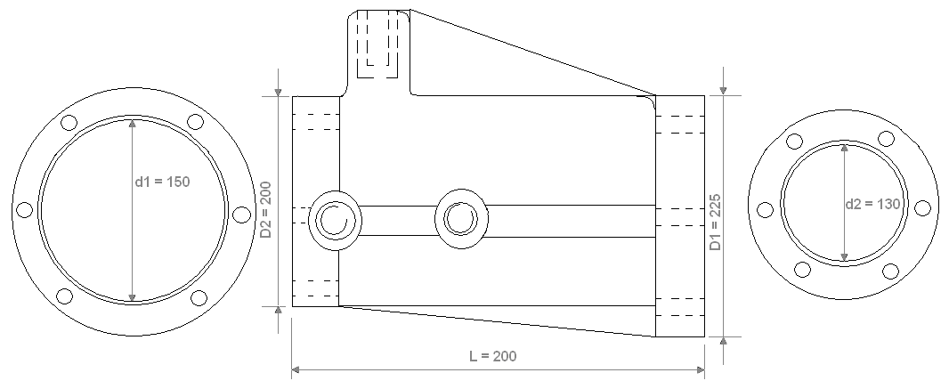


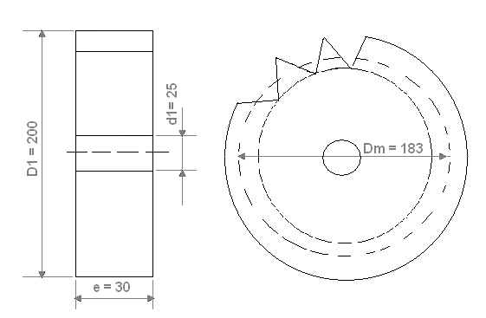
Example - Two Automotive Parts
Aluminum transfer case
Steel pinion gear
Simple question: What is better?
  Virgin manufacturing & disposal
  Recycling
  Remanufacturing
… and by how much?
NSF Grant # 0522116

Slide 20
Al Process Energy Consumption (kWh/ton)
Refining processes have the highest energy consumption
De-Materialization should be higher priority from an energy point of view → product design
Machining processes energy consumption is low
NSF Grant # 0522116

Slide 21
Steel Processing Energy Consumption
De-Materialization again will result in higher gains from an energy point of view
Refining processes have the highest energy consumption
Machining processes energy consumption is low
NSF Grant # 0522116

Slide 22
Energy Consumption in Manufacturing Sectors
Consumption of Energy (Site Energy) for All Purposes (First Use) for Selected Industries, 1998 and 2002 (Trillion Btu)
 |  | MECS Survey Years
NAICS | Subsector and Industry | 1998 | 2002
311 | Food | 1,044 | 1,123
312 | Beverage and Tobacco Products | 108 | 105
313 | Textile Mills | 256 | 207
314 | Textile Product Mills | 50 | 60
315 | Apparel | 48 | 30
316 | Leather and Allied Products | 8 | 7
321 | Wood Products | 509 | 377
322 | Paper | 2,747 | 2,363
323 | Printing and Related Support | 98 | 98
324 | Petroleum and Coal Products | 7,320 | 6,799
325 | Chemicals | 6,064 | 6,465
326 | Plastics and Rubber Products | 328 | 351
327 | Nonmetallic Mineral Products | 979 | 1,059
331 | Primary Metals | 2,560 | 2,120
332 | Fabricated Metal Products | 445 | 388
333 | Machinery | 217 | 177
334 | Computer and Electronic Products | 205 | 201
335 | Electrical Equip., Appliances, and Components | 143 | 172
336 | Transportation Equipment | 492 | 429
337 | Furniture and Related Products | 88 | 64
339 | Miscellaneous | 89 | 71
 | Manufacturing | 23,796 | 22,666
Manufacturing process energy savings are small when majority is embodied in upfront material production/refining
2014 data is at: https://www.eia.gov/consumption/manufacturing/data/2014/
Source: Energy Information Administration, Form EIA-846, Manufacturing Energy Consumption Surveys, 1998 and 2002, http://www.eia.doe.gov/emeu/efficiency/mecs_trend_9802/mecs9802_table1a.html

Slide 23
Regional Variation in Electricity CO₂ Emissions
Relocating manufacturing to a locality with renewable power often has a larger carbon footprint effect than any process efficiency improvement
http://www.eia.doe.gov/oiaf/1605/emission_factors.html
  GA Power Plant Bowen (Cartersville):
  CO2 emission: 0.9 kg/kWh
  H2O evaporation: 0.4 gallons/kWh

Slide 24

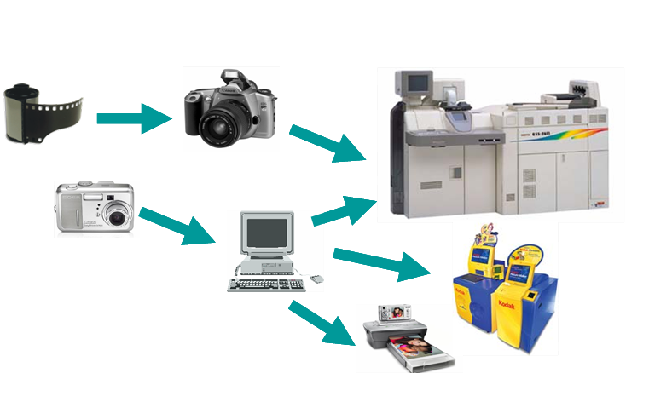
Opportunities
Think “holistically” about your product.
Your product is part of a bigger system
  Thus, think “system” instead of “product”
Thinking bigger may actually reduce cost
  Can you reuse parts?
  Can you lease instead of sell/buy?
  Is the product really the end, or is it just a provider of a function?

Slide 25
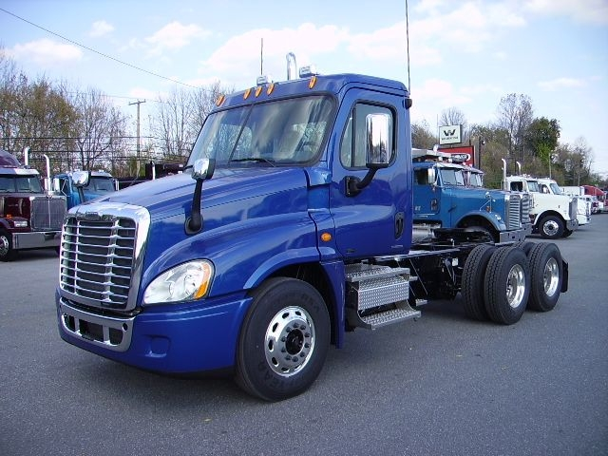
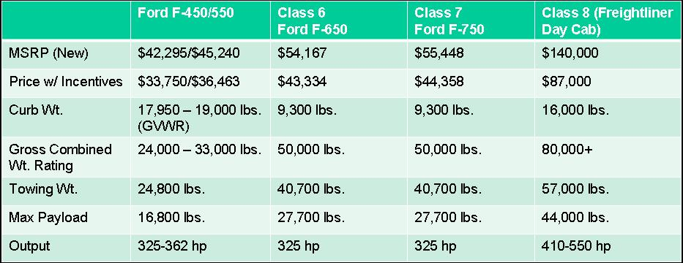
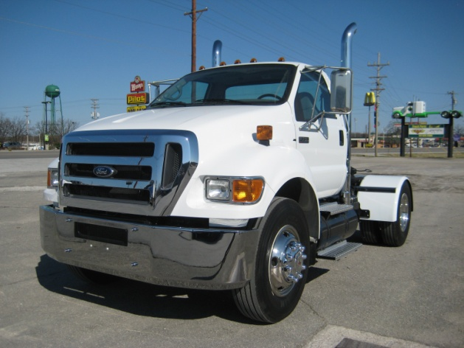
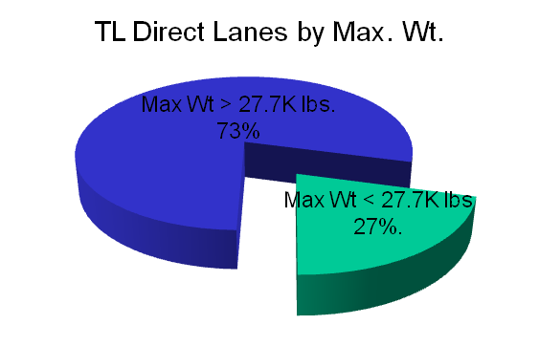
Importance of Sound Engineering
Many systems are over-engineered
Appropriate technology and sound engineering can go a long way towards sustainability
Switching from Class 8 High Duty Diesel trucks to Ford F750 can provide significant savings.
Ideas were triggered by quest for fuel savings.

Slide 26
In Closing
In your project, you can
  Check and include MSDS sheets for potential problem materials
  Check for RoHS compliance when ordering (electronic) parts
  Quantify and minimize amount of materials used
  Quantify and minimize energy consumption
  Minimize wasteful manufacturing processes
  Increase recyclability by reducing number of different materials
  Avoid sourcing parts from questionable companies
  Etc.
Think about and discuss the social and environmental consequences of your products
  positive and negative
But don’t forget the basics – good engineering & decision making is good for people-planet-profit!

