Slide 1

Protecting Your Company’s Technology and Products
Georgia Institute of Technology
January 25, 2016
Daniel E. Sineway
Intellectual Property Attorney
Morris, Manning & Martin, LLP

Slide 2
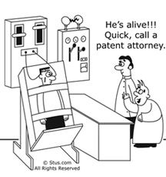
Patent Humor

Slide 3
Agenda
  Intellectual Property Overview
  Discuss Importance of IP
  Questions

Slide 4
Four Primary Areas of
Intellectual Property Law
Patent – Protects “inventions” in the form of processes, machines, compositions of matter, and articles of manufacture
Copyright – Protects original works of authorship
Trademark – Protects brands or product names
Trade Secret – Protects information that is not generally known, and has economic value because it is not generally known

Slide 5
Patent
Protects new and useful processes, machines, articles of manufacture, and compositions of matter
Prevents others from making, using, selling, etc. the patented subject matter
Patents must be applied for within one (1) year of any public use, public disclosure, or offer for sale of a technology
Novel (§102) and nonobvious (§103)
Software is protectable (probably)
Limited monopoly

Slide 6
What is Not Patentable?
Laws of nature
Natural phenomena
Abstract ideas (e.g. pure mathematical algorithms)
Printed matter
An inoperable device (e.g. a perpetual motion machine; cold fusion device)

Slide 7
Patent
How to Protect?
  Must file patent application with US Patent & Trademark Office (USPTO)
    Patent application is a detailed document that describes how to make and use a given technology
    Often have to “negotiate” with patent examiners to amend application and settle on allowable scope of patent protection
  “Provisional” applications provide temporary protection at (typically) low cost

Slide 8
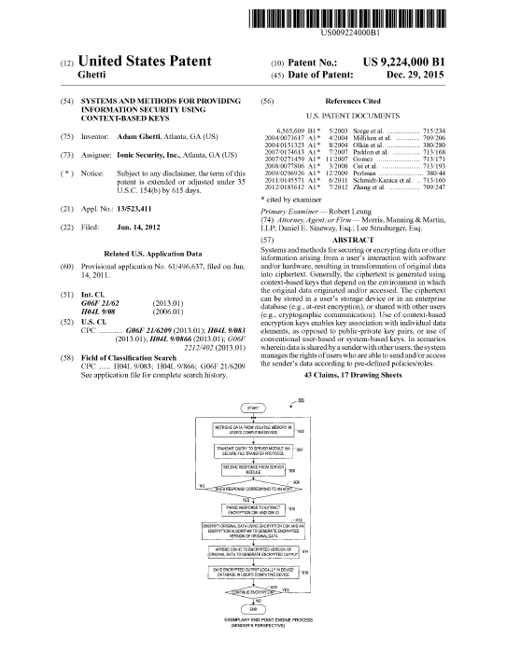
Patent

Slide 9
Advantages of Patent Protection
Generally highest level of protection for IP
Typically greatest monetary damages upon infringement
Patents generally add value to a company, even if they are never used or enforced
Deterrent
Discrete property
Marketing -- “patented technology” or “patent pending”

Slide 10
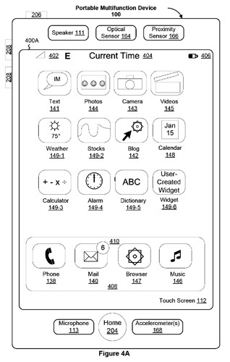
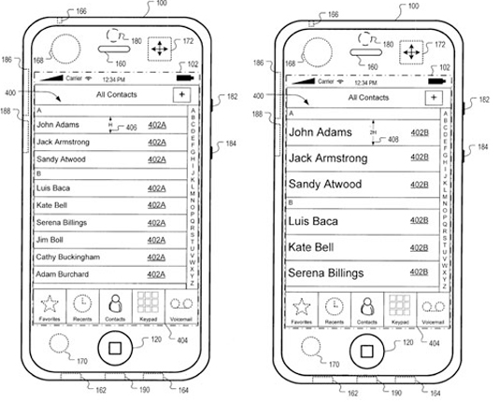
iPhone Patent Drawings

Slide 11
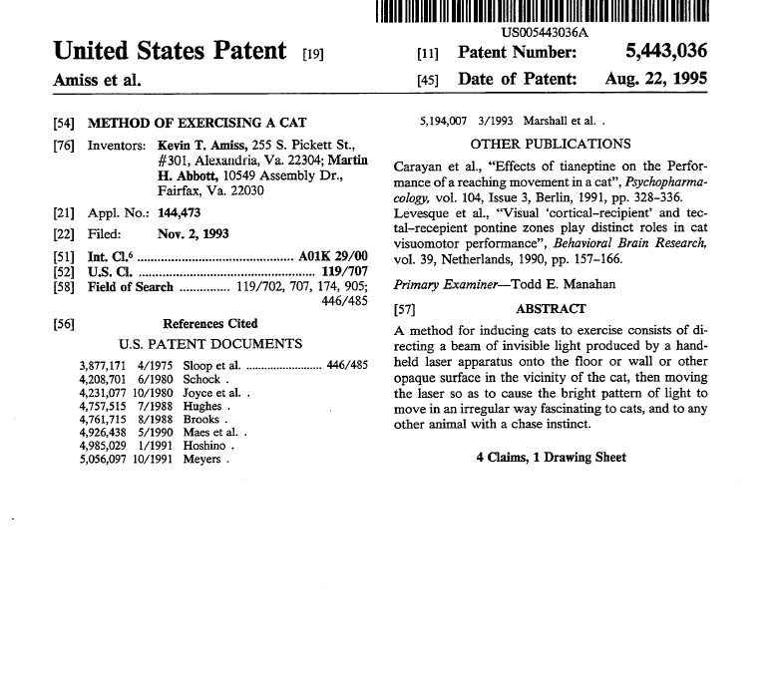
Patentable?

Slide 12
What is Going on with Patents?
Big Deals
Recent large patent transactions:
  Google sold Motorola Mobility to Lenovo (2014) – but kept most of the patents … wonder why?
  Microsoft bought Nokia phone unit for $5 B, license (not buy) patents for $2 B (2013)
  AOL sold 925 patents to Microsoft for $1.05 B (billion)(2012)
  Microsoft sold 650 patents to Facebook for $550 M (2012).
  Interdigital sold 1700 patents for 3G/LTE to Intel for $375 M
Patent wars being fought in certain key technologies: life sciences, mobile / wireless technologies, computer software

Slide 13
What is Going on with Patents?
Big Damages (Top 10 1995-2013)
Year | Plaintiff | Defendant | Technology | Award (MM)
2009 | Centocor Ortho | Abbott Labs | Arthritis drugs | $ 1,848
2007 | Lucent | Microsoft | MP3 | 1,538
2012 | Carnegie Mellon | Marvell | Noise reducing | 1,169
2012 | Apple | Samsung | Smartphones | 1,049
2012 | Monsanto | E.I. Dupont | Gen. Modified | 1,000
2010 | Mirror Worlds | Apple | Operating Sys | 626
2011 | Saffran, MD | J&J | Stents | 593
2003 | Eolas | Microsoft | Browser | 521
2008 | Saffran, MD | Boston Scientific | Stents | 432
2009 | Uniloc USA, Inc. | Microsoft | E-Licensing | 388
Source: PriceWaterhouseCoopers 2013 Patent Litigation Study, page 10 (initial, unadjusted)

Slide 14
What is Going on with Patents?
Lots of Supreme Court Activity
Limelight Networks v. Akamai | Decided 2014 | Redirecting requests for internet content; induced infringement?
Nautilus v. Biosig | Decided 2014 | Is patent invalid due to “indefiniteness” / ambiguous claims?
Octane Fitness v. ICON | Decided 2014 | Aware of attorney fees to prevailing party / affect trolls?
CLS Bank v. Alice Corp. | Decided 2014 | Are software / business methods patentable subject matter?

Slide 15
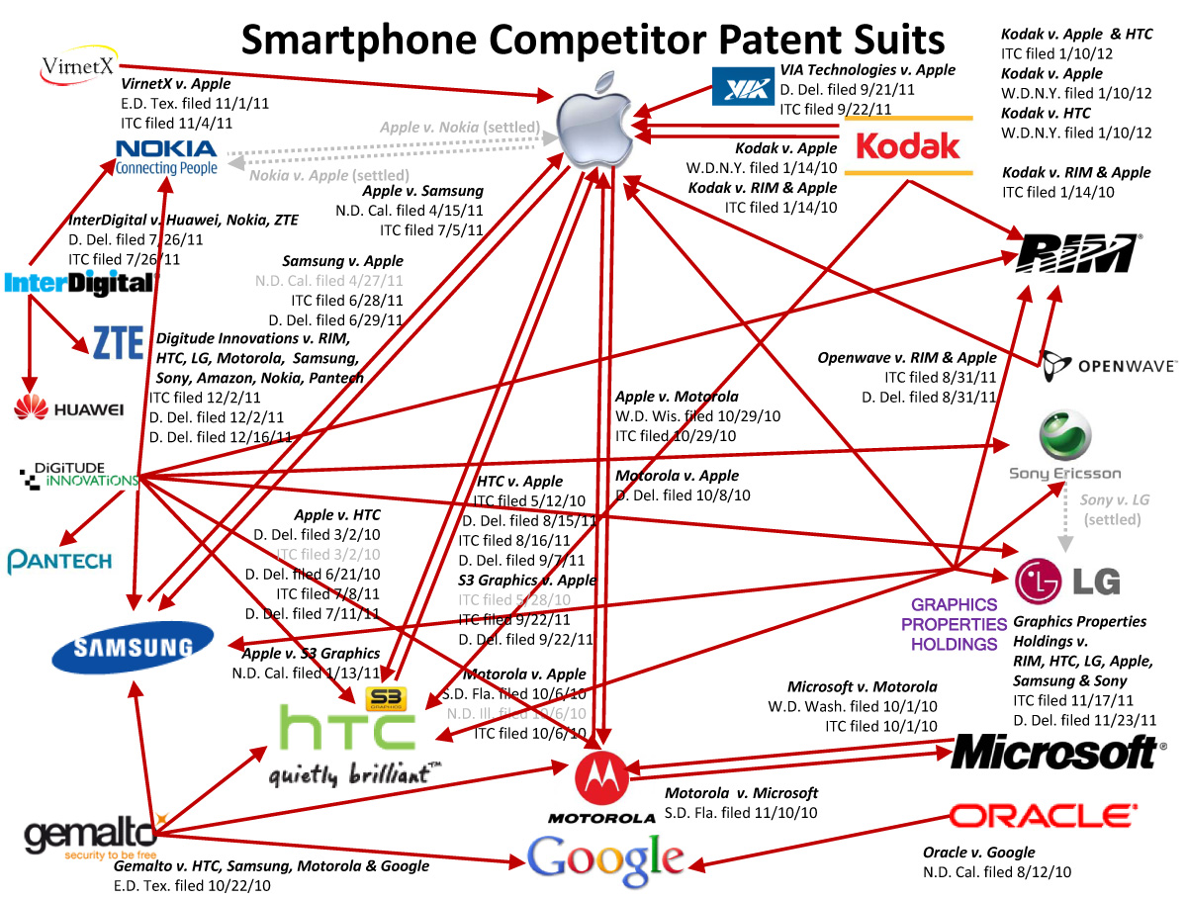
What is Going on with Patents? Patent Wars
Nowadays, it is mostly Apple v. Samsung
Graphic: Smartphone Patent Wars
PC Magazine (January 2012)

Slide 16

What is Going on with Patents?
“TROLLS” (a/k/a “non-practicing entities” or “patent monetization entities”
Patents often broad, often early, often of questionable validity
Examples: scan-to-email, QR codes in coupons, promotions in text messages, podcasts, pull-down menus on websites
Important note that many fail to remember: NPEs “Make Market” for IP value

Slide 17

Copyright
Protects original works of authorship fixed in a tangible medium (books, movies, paintings, sculpture, software, etc.)
Protects the expression of an idea, not the idea itself
Software is protectable via copyright
Protection is against copying -- independent creation is a defense
Only “modicum of creativity” required

Slide 18
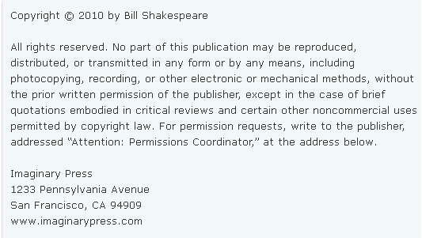
Copyright
How to protect?
  Automatic protection, but enhanced protection for registration (damages, prerequisite to lawsuit, etc.)
  “Poor man’s copyright” = not real
  Copyright notices are recommended

Slide 19

Copyright
Copyrightable?

Slide 20

Copyright
Copyrightable?

Slide 21


Trademark
Protects brands or product names
  Protects “goodwill” – can keep competitors from “free-riding” on the brand and customer satisfaction you have built.
Used to identify the “source” of goods or services
Priority of use in commerce is important
Confusingly similar marks are not allowed
  But, consider and

Slide 22
Trademark
Spectrum of Protection:
  Fanciful (KODAK)
  Arbitrary (APPLE)
  Suggestive (CITIBANK)
  Descriptive (FRESH MARKET)
    But consider, “inherently distinctive”
  Generic (AUTOMOBILE)

Slide 23
Trademark
How to Protect?
  Common law protection based on use in commerce, but limited to scope of actual use (use “TM”)
  Can file for federal trademark registration for increased rights
    Immediate nationwide rights
    Potential for increased damages
    Confers right to use ® symbol
    Mark is “findable” by others that may use potentially infringing marks
  Searching to avoid other marks

Slide 24
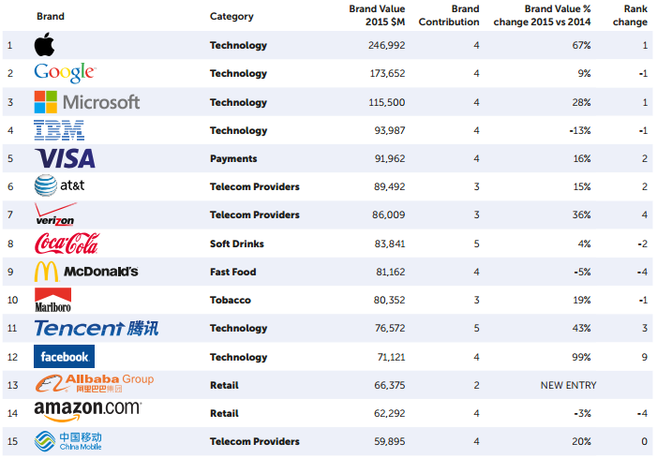
Most Valuable Brands -- 2015

Slide 25
Trade Secret
Generally:
  Protects information that is not generally known and has value because not generally known
  Must undertake efforts to maintain secrecy
  No limit on protection
  No filings or registrations
How to Protect:
  Requires affirmative steps to protect secrecy, such as employment agreements, non-disclosure agreements, policies regarding secrecy, physical barriers, etc.

Slide 26

Why Do Companies Pursue IP?
Add value to company
Protection
Competitive advantage (barrier to entry)
Bargaining chips
Enforcement / Monetization
Administrative efficiencies
Discrete properties that can be bought, sold, and traded

Slide 27
Thanks!
Daniel E. Sineway
Intellectual Property Attorney
Morris, Manning & Martin, LLP
404-364-7421
dsineway@mmmlaw.com

